Slide 1

Keystroke Logging Demonstration
Name:Parvez Thabarak Vavilathota
Email:pv2636@srmist.edu.in
STU ID : STU65793b747b12c1702443892

Slide 2

PROBLEM STATEMENT
With the rapid growth of cyber threats, understanding how keyboard-based attacks such as keylogging work is essential for cybersecurity students. Many learners lack hands-on exposure to how keystroke monitoring operates at the system level. This project addresses the need for a controlled, educational environment to study keyboard event capturing, logging mechanisms, and their security implications.

Slide 3
Project Description
This project is an educational key event monitoring application developed using Python. It captures keyboard events such as key press, key hold, and key release using a listener mechanism.
The application provides a Graphical User Interface (GUI) built with Tkinter, allowing the user to start the keylogger interactively. Logged keystrokes are stored in both text (.txt) and JSON (.json) formats for easy analysis.
The project is strictly designed for learning and cybersecurity lab purposes, helping students understand how keyloggers function and how such threats can be detected and mitigated.

Slide 4

WHO ARE THE END USERS?
Cybersecurity students
Ethical hacking learners
Python developers exploring system-level programming
Academic institutions (for lab demonstrations)
⚠️ This application is intended only for authorized and ethical use.

Slide 5

Technology Used
Programming Language: Python
GUI Framework: Tkinter
Keyboard Listener: pynput library
Data Storage:
Text file (logs.txt)
JSON file (logs.json)
Concepts Used:
Event listeners
Multithreading
File handling
GUI development

Slide 6
RESULTS
Successfully captures keyboard events (Pressed, Held, Released)
Logs keystrokes in readable and structured formats
GUI allows easy execution without command-line interaction

Slide 7
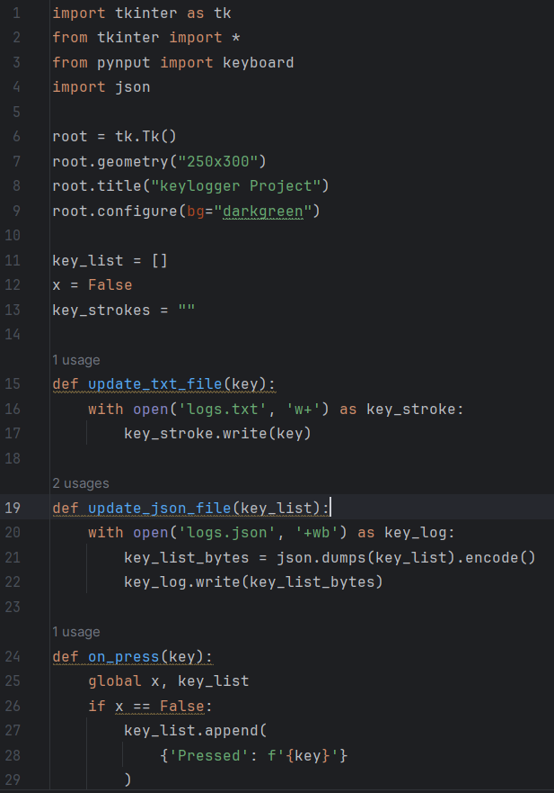
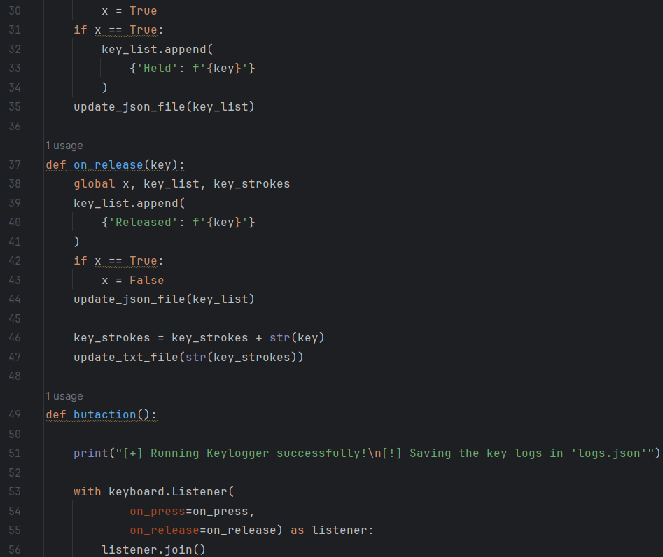
RESULTS

Slide 8
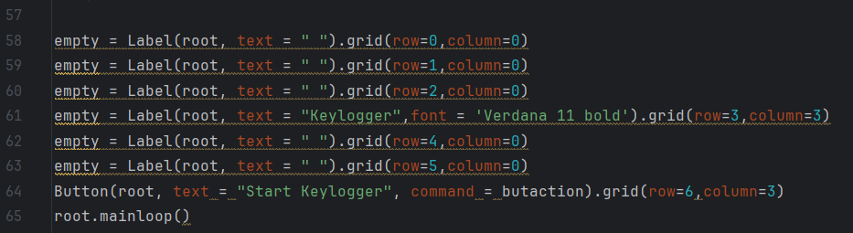
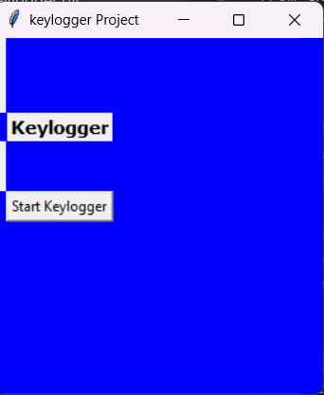
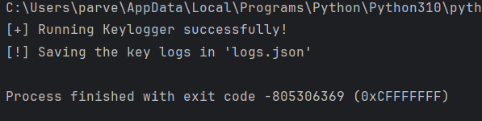
RESULTS
DEMO VIDEO link : https://drive.google.com/file/d/1QpfznDRM2yP6jR3HFbWN6NU7MxoiDb_z/view?usp=drive_link

Slide 9
Thank you
.
.

